Slide 1

Content Based Image Retrieval
Natalia Vassilieva
HP Labs Russia

Slide 2
Tutorial outline
Lecture 1
  Introduction
  Applications
Lecture 2
  Performance measurement
  Visual perception
  Color features
Lecture 3
  Texture features
  Shape features
  Fusion methods
Lecture 4
  Segmentation
  Local descriptors
Lecture 5
  Multidimensional indexing
  Survey of existing systems

Slide 3
Lecture 3
Texture features
Shape features
Fusion methods

Slide 4
Lecture 3: Outline
Texture features
  Statistical
  Spectral
  Comparison
Shape features
  Boundary based
  Region based
  Comparison
Fusion methods
Texture features
  Statistical
  Spectral
  Comparison
Shape features
  Boundary based
  Region based
  Comparison
Fusion methods

Slide 5
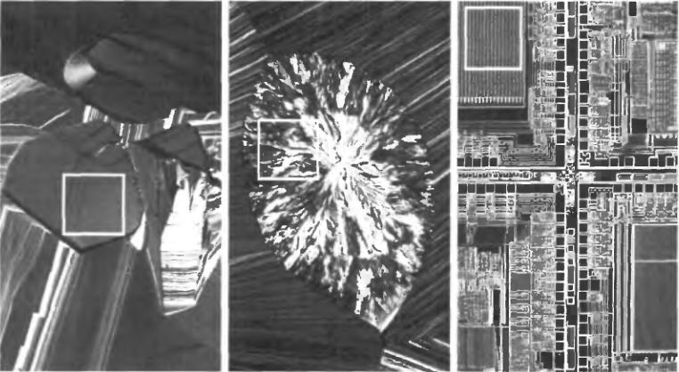
Texture features
What is texture?
Smooth
Rough
Regular

Slide 6
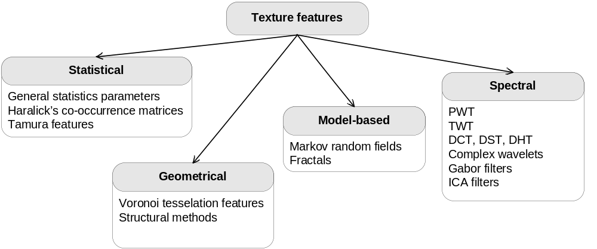
Texture features

Slide 7





Texture features
General statistics
Based on intensity histogram of the whole image or its regions:
– histogram of intensity, L – number of intensity levels.
– central moment of order n.
– average intensity.
– variance, is a measure of contrast.
, R=0 where intensity is equal.
– a measure of histogram assimetry.

Slide 8


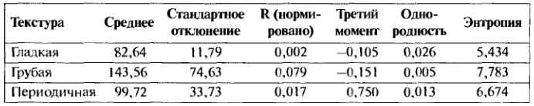
Texture features
General statistics (2)
– a measure of contrast of homogeneity
(max for homogeneous areas ).
– entropy, a measure of variability
(0 for homogeneous areas ).
Texture
Average
Deviation
R
μ₃
U
Entropy
Smooth
Rough
Regular

Slide 9
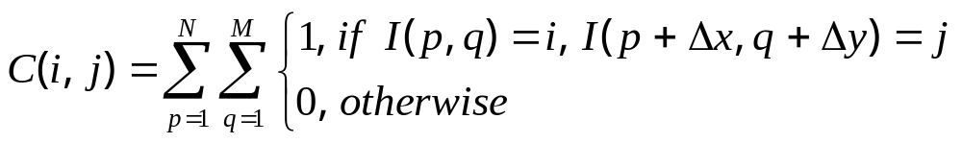

Texture features
Grey Level Co-occurrence Matrices (GLCM):
GLCM - matrix of frequencies at which two pixels, separated by a certain vector, occur in the image.
– separation vector;
I(p,q) – intensity of a pixel in position (p, q).

Slide 10
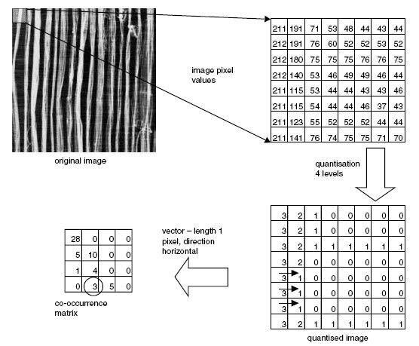

GLCM – an example

Slide 11
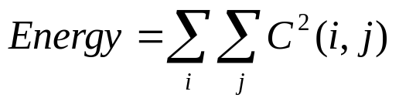
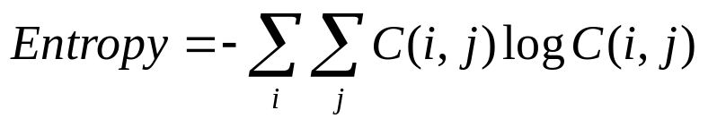
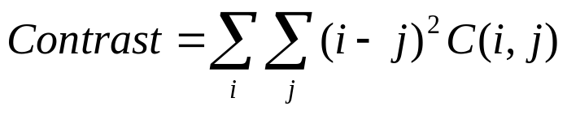
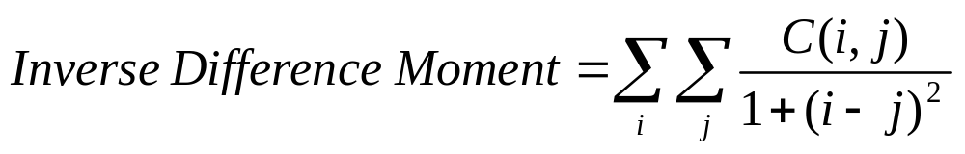
GLCM – descriptors
Statistical parameters calculated from GLCM values:
– is minimal when all elements are equal
– a measure of chaos,
is maximal when all elements are equal
– has small values when big elements are
near the main diagonal
– has small values when big elements are
far from the main diagonal
Notes:
См. Стр. 952 чудо-книги

Slide 12
Texture features: Tamura features
Features, which are important for visual perception:
Coarseness
Contrast
Directionality
Line-likeness
Regularity
Roughness
Tamura image:
Coarseness-coNtrast-Directionality – points in 3-D space CND
Features:
Euclidean distance in 3D (QBIC)
3D histogram (Mars)

Slide 13
Texture features: spectral

Slide 14
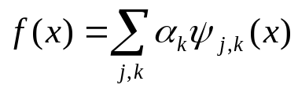
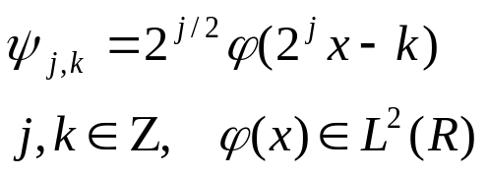
Texture features: wavelet based
Wavelet analysis – decomposition of a signal:
Basis functions:
– scaling function
– mother wavelet
A set of basis functions – filters bank
Image
Filter 1
Energy 1
Filter 2
Energy 2
Feature vector
Filter N
Energy N

Slide 15
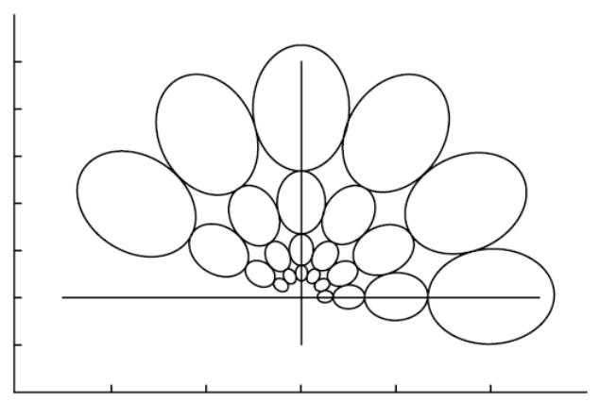
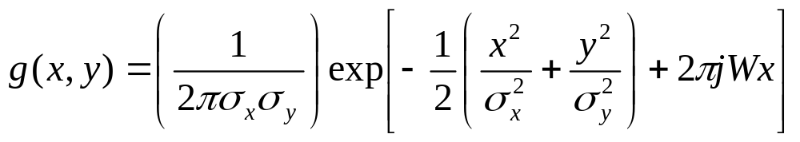
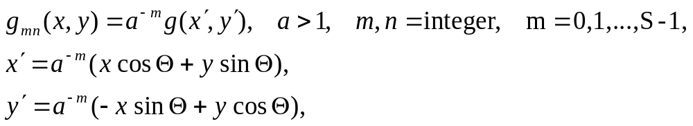


Texture features: Gabor filters
Mother wavelet: Gabor function
Filters bank:
К – a number of directions,
S – a number of scales,
U_{h}, U_{l} – max and min of frequencies taken into consideration.

Slide 16

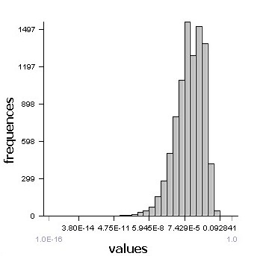
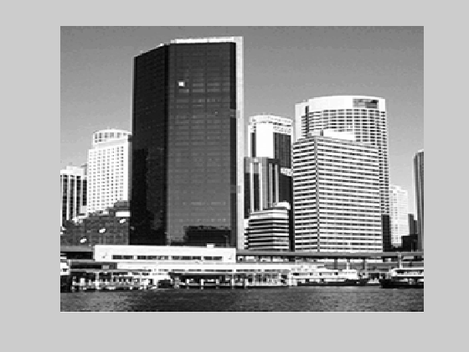
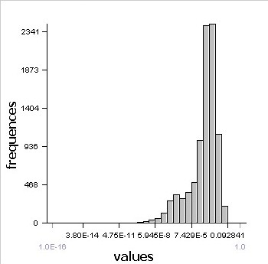
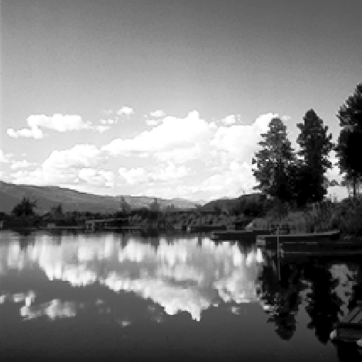

Texture features: ICA filters
Filters are obtained using Independent Component Analysis
dist(I₁,I₂) = KL_{H}(H_{1i} , H_{2i})
I₁
N
Σ
i=1
H. Borgne, A. Guerin-Dugue, A. Antoniadis. Representation of images for classification with independent features. Pattern Recognition Letters, vol. 25, p. 141-154, 2004
…
I₂
N filters

Slide 17
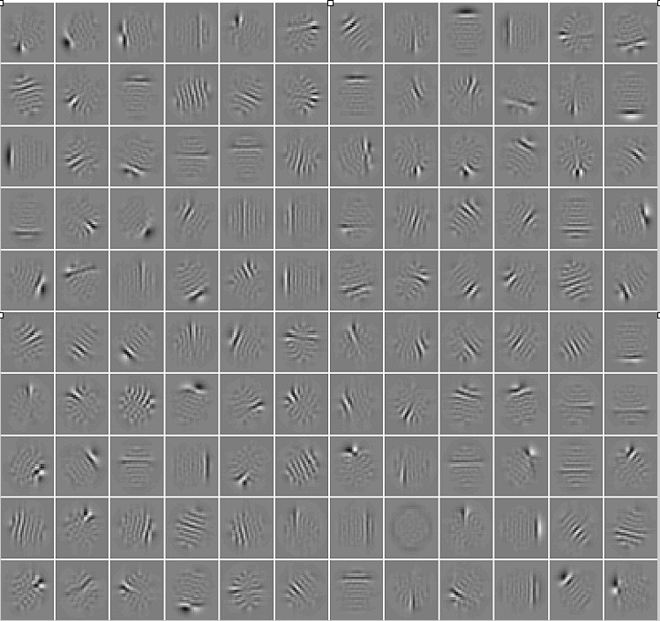
ICA Filters

Slide 18
Lecture 3: Outline
Texture features
  Statistical
  Spectral
  Comparison
Shape features
  Boundary based
  Region based
  Comparison
Fusion methods

Slide 19
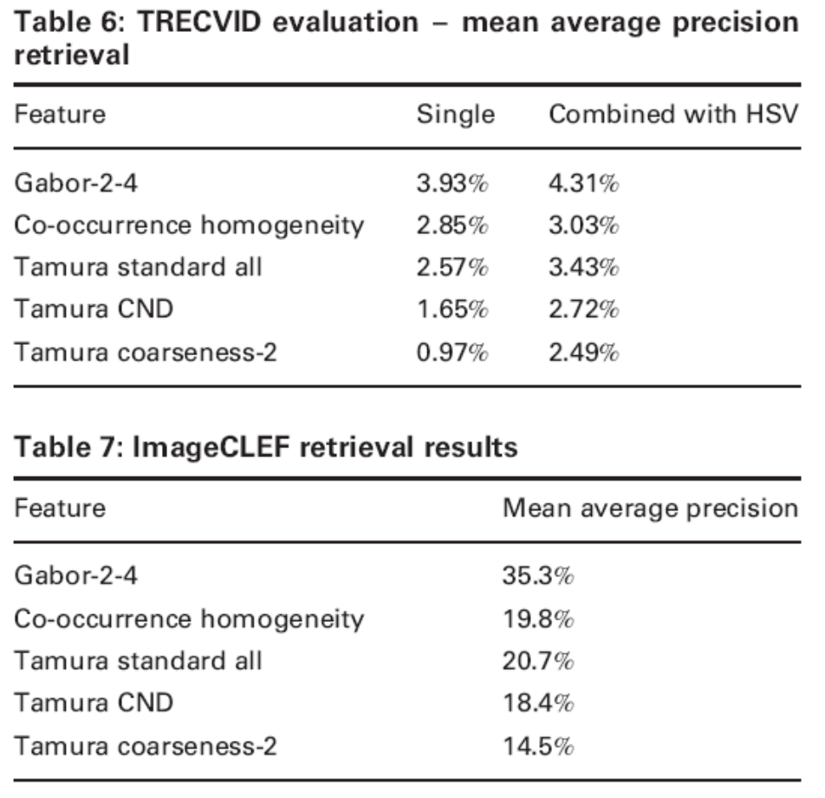
Texture features: comparison
In the context of image retrieval!
P. Howarth, S. Rüger. Robust texture features for still image retrieval.
In Proc. IEE Vis. Image Signal Processing, vol. 152, No. 6, December 2006

Slide 20
Texture features: comparison (2)
Gabor filters v. s. ICA filters
Image classification task:
Collection of angiographic images
  ICA filters performs better by 13%
Brodatz texture collection
  ICA filters perform better by 4%
Snitkowska, E. Kasprzak, W. Independent Component Analysis of Textures in Angiography Images. Computational Imaging and Vision, vol. 32, pages 367-372, 2006.

Slide 21
Lecture 3: Outline
Texture features
  Statistical
  Spectral
  Comparison
Shape features
  Boundary based
  Region based
  Comparison
Fusion methods

Slide 22
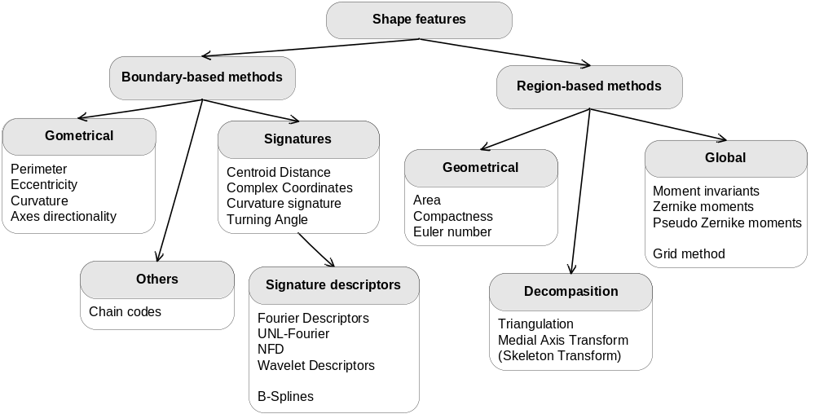
Shape features
Spectral descriptors

Slide 23
Requirements to the shape features
Translation invariance
Scale invariance
Rotational invariance
Stability against small form changes
Low computation complexity
Low comparison complexity

Slide 24
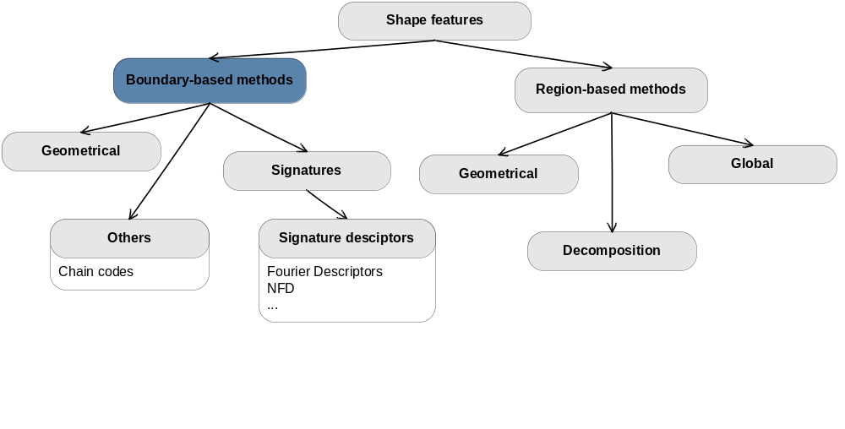
Boundary-based features

Slide 25
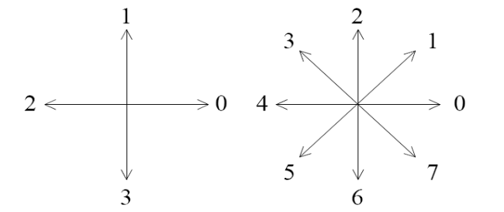
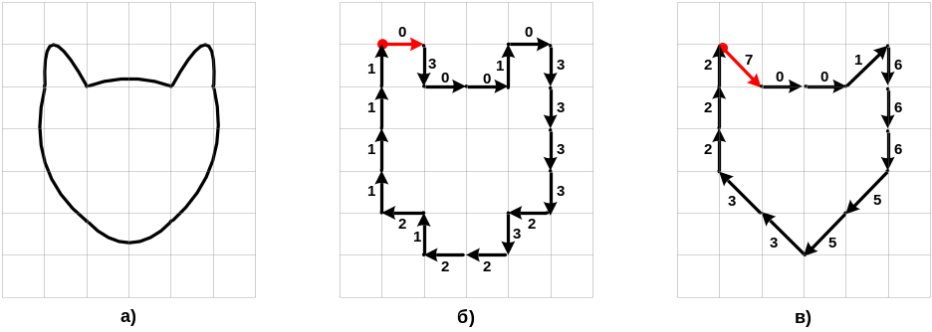
Chain codes
Directions for 4-connected and 8-connected chain codes:
A: 03001033332322121111
B: 70016665533222
Example:
Starting point invariance: minimal code
70016665533222 -> 00166655332227
Rotation invariance: codes subtraction
00166655332227 -> 01500706070051
A
B

Slide 26
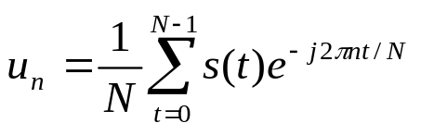
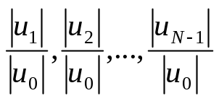
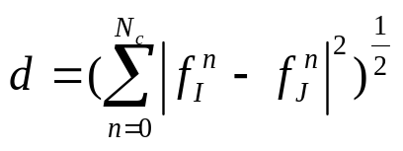
Fourier descriptors
1. Signature calculation (2D -> 1D):
Centroid – contour distance
Complex coordinates: z(t) = x(t) + iy(t)
...
2. Perform the discrete Fourier transform, take coefficients (s(t) – signature):
3. Normalization (NFD – Normalized Fourier Descriptors):
4. Comparison:

Slide 27
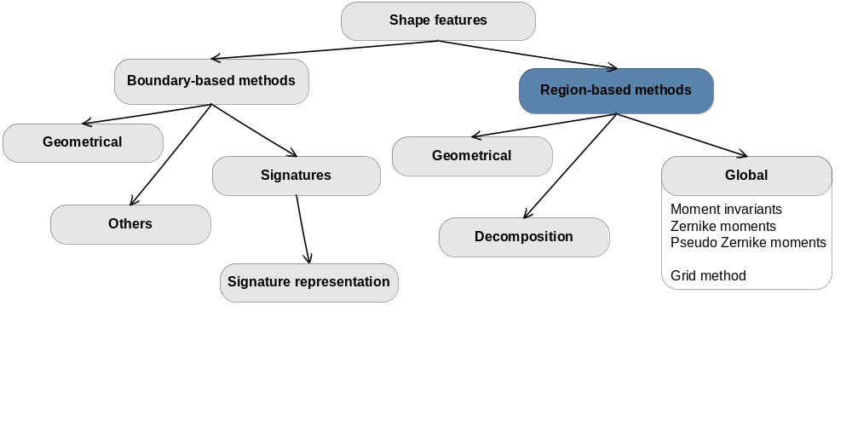
Region-based features

Slide 28
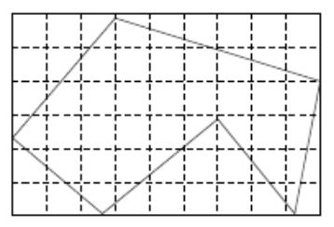
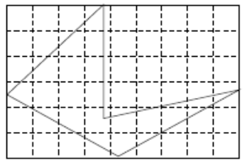
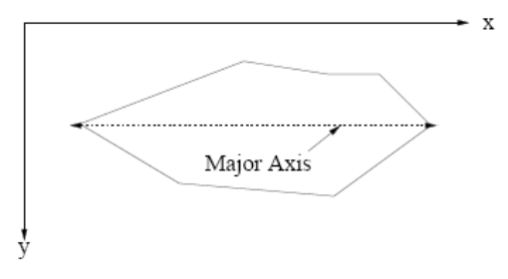
Grid-method
А
А: 001111000 011111111 111111111 111111111 111110111 0111000011
Б
Б: 001100000 011100000 111100000 111101111 111111110 001111000
Invariance:
Normalization by major axe:
direction;
scale;
position.

Slide 29
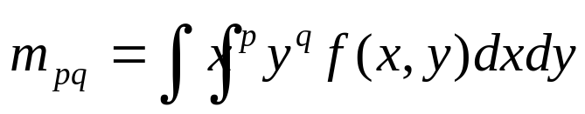
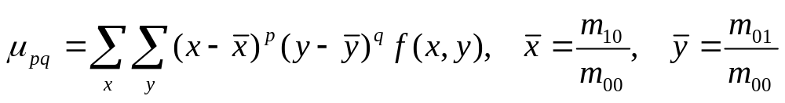
Moment invariants
The moment of order (p+q) for a two-dimension continuous function:
Central moments for f(x,y) – discrete image:
Feature vector:
Seven scale, translation and rotation invariant moments were derived based on central normalized moments of order p + q = 2; 3.

Slide 30
Lecture 3: Outline
Texture features
  Statistical
  Spectral
  Comparison
Shape features
  Boundary based
  Region based
  Comparison
Fusion methods

Slide 31
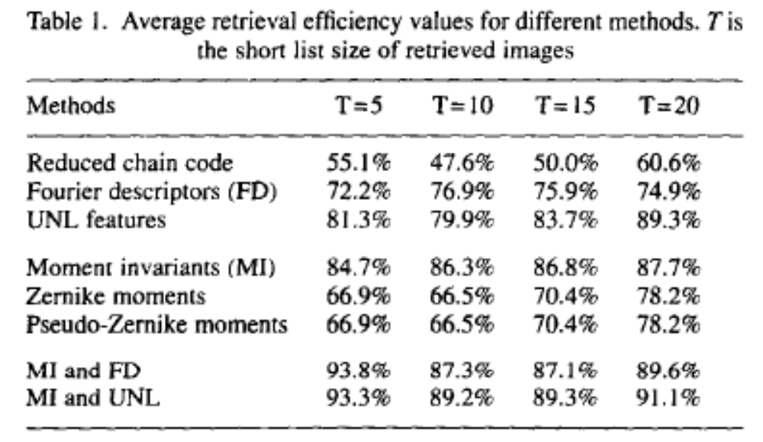
Shape features comparison
Mehtre B. M., Kankanhalli M. S., Lee W. F. Shape measures for content based image retrieval: a comparison. Inf. Processing and Management, vol. 33, No. 3, pages 319-337, 1997.

Slide 32
Lecture 3: Outline
Texture features
  Statistical
  Spectral
  Comparison
Shape features
  Boundary based
  Region based
  Comparison
Fusion methods

Slide 33
Data fusion in CBIR
annotations
color (2)
color
texture
shape
Combined search
(different features)
Refine search results
(different algorithms for the same feature)
Supplement search results (different datasets)
fusion
result

Slide 34
Fusion of retrieval result sets
Fusion of weighted lists with ranked elements:
ω₁
(x¹₁, r¹₁), (x¹₂, r¹₂), … , (x¹_{n}, r¹_{n})
ω₂
(x²₁, r²₁), (x²₂, r²₂), … , (x²_{k}, r²_{n})
?
…
ω_{m}
(x^{m}₁, r^{m}₁), (x^{m}₂, r^{m}₂), … , (x^{m}_{l}, r^{m}_{l})
Existing approaches in text retrieval:
CombMax, CombMin, CombSum
CombAVG
CombMNZ = CombSUM * number of nonzero similarities
ProbFuse
HSC3D
Notes:
(1) How to merge fairly?
How to normalize the channels' evaluation scores in similar scale? Sometime rank can be used as a method of normalization.
Tuning merging parameters in the best way.
(2) How to merge efficiently?
It is not necessary to merge the full result list. Truncated list merge is preferred.
Merge can be executed in parallel,hierarchy merge or pair-wise merge can be used.
(3) How to merge effectively?
Different merging algorithms perform differently for specific dataset. Merging algorithms such as COMBSUM, COMBMIN, COMBMAX (Shaw 1995).
Fuzzy-AND merge and fuzzy-OR merge (Wu 2000) can be used.

Slide 35
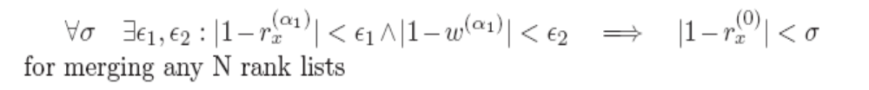
Fusion function: properties
Depend on both weight and rank
Symmetric
Monotony by weight and rank
MinMax condition /CombMin, CombMax, CombAVG/:
Additional property – “conic” property: non-linear dependency from weight and rank; high weight, high rank – influence bigger to the result than several inputs with low weight, low rank.

Slide 36
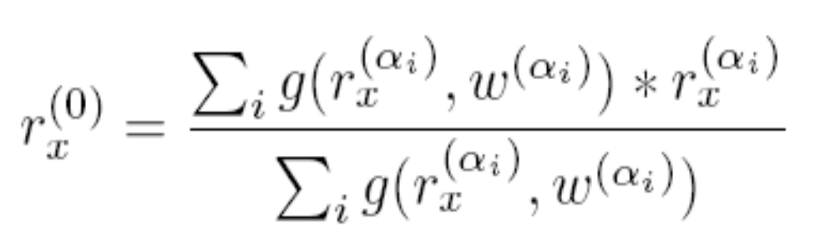
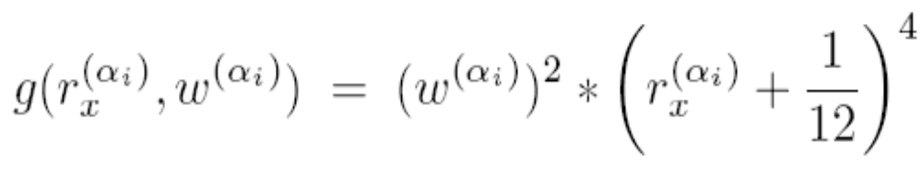
Weighted Total with Gravitation Function
CombAVG as a base, but use gravitation function instead of weight:
where

Slide 37
WTGF: some results
Experiments on search in semi annotated collections and of color and texture fusion (compare with CombMNZ)
WTGF is good when:
  There are a lot of viewpoints.
  Viewpoints are very different (different opinions regarding the rank of the same element).
  Viewpoints have different reliability.
CombMNZ is good when:
  Viewpoints have the same reliability.
  Viewpoints have similar opinions.
Natalia Vassilieva, Alexander Dolnik, Ilya Markov. Image Retrieval. Combining multiple search methods’ results. In "Internet-mathematics" Collection, 46—55, 2007.

Slide 38
Adaptive merge: color and texture
Dist(I, Q) = α*C(I, Q) + (1 - α)*Т(I, Q),
C(I, Q) – color distance between I and Q;
T(I, Q) – texture distance between I and Q;
0 ≤ α ≤ 1
Hypothesis:
Optimal α depends on features of query Q. It is possible to distinguish common features for images that have the same “best” α.
Ilya Markov, Natalia Vassilieva, Alexander Yaremchuk. Image retrieval. Optimal weights for color and texture fusion based on query object. In Proceedings of the Ninth National Russian Research Conference RCDL'2007

Slide 39
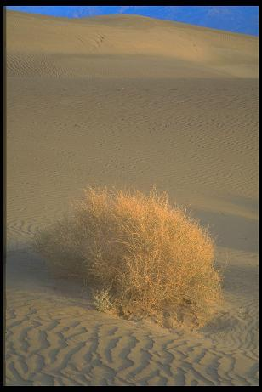

Example: texture search

Slide 40
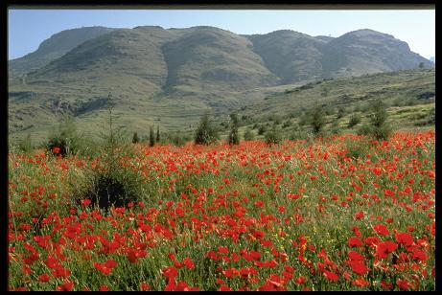
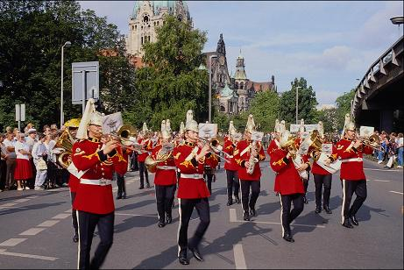
Example: color search

Slide 41
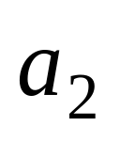
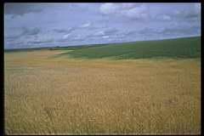
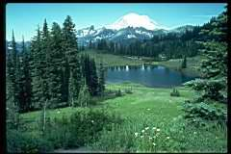
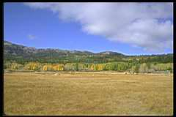
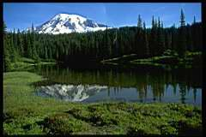
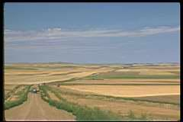
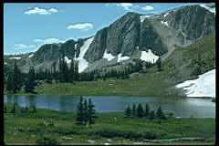
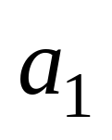
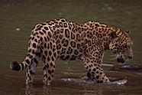
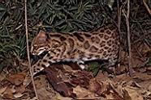


Mixed metrics: semantic groups

Slide 42

Experimental results 1
It is possible to select the best value of a
Cluster 6
Precision
Cluster 7
Cluster 8
Value of a

Slide 43

Experimental results 2
Adaptive mixed-metrics increase precision

Slide 44




Adaptive merge: color and color

Slide 45







Adaptive merge: color and color

Slide 46

Color fusion
CombMNZ (Moments + HSL histogram)

Slide 47
Ranked lists fusion: application area
Search by textual query in semi annotated image collection
Textual query
by annotations
…
tr₁
content-based
…
TextResult₁, textrank₁
TR₂, tr_{2,}
...
tr₂
Result
…

Slide 48



Retrieve by text: fusion results
Size of input lists

Slide 49
Lecture 3: Resume
Texture features
  Statistics (Haralik’s co-occurance matrices, Tamura features)
  Spectral features are more efficient (Gabor filters, ICA filters)
Shape features
  Boundary-based (Fourier descriptors)
  Region-based (Moment invariants)
Fusion methods
  Are very important
  Need to choose based on a particular fusion task

Slide 50
Lecture 3: Bibliography
Haralick R. M., Shanmugam K., Dienstein I. Textural features for image classification. In IEEE Transactions on Systems, Man and Cybernetics, vol. 3(6), pp. 610 – 621, Nov. 1973.
Tamura H., Mori S., Yamawaki T. Textural features corresponding to visual perception. In IEEE Transactions on Systems, Man and Cybernetics, vol. 8, pp. 460 – 472, 1978.
Tuceryan M., Jain A. K. Texture analysis. The Handbook of Pattern Recognition and Computer Vision (2nd Edition), by C. H. Chen, L. F. Pau, P. S. P. Wang (eds.), pp. 207-248, World Scientific Publishing Co., 1998.
Tuceryan M., Jain A. Texture segmentation using Voronoi polygons. In IEEE Transactions on Pattern Analysis and Machine Intelligence, vol. 12, No 2, pp. 211 – 216, February 1990.
Walker R., Jackway P., Longstaff I. D. Improving co-occurrence matrix feature discrimination. In Proc. of DICTA’95, The 3rd Conference on Digital Image Computing: Techniques and Applications, pp. 643 – 648, 6-8 December, 1995.

Slide 51
Lecture 3: Bibliography
Li B., Ma S. D. On the relation between region and contour representation. In Proc. of the IEEE International Conference on Pattern Recognition, vol. 1, pp. 352 – 355, 1994.
Lin T.-W., Chou Y.-F. A Comparative Study of Zernike Moments for Image Retrieval. In Proc. of 16th IPPR Conference on Computer Vision, Graphics and Image Processing (CVGIP 2003), pp. 621 – 629, 2003.
Loncaric S. A survey of shape analysis techniques. In Pattern Recognition, vol. 31(8), pp. 983 – 1001, 1998.
Luren Y., Fritz A. Fast computation of invariant geometric moments: A new method giving correct results. In Proc. of IEEE International Conference on Image Processing, 1994.
Zakaria M. F., Vroomen L. J., Zsombor-Murray P. J. A., van Kessel J. M. H. M. Fast algorithm for the computation of moment invariants. In Pattern Recognition, vol. 20(6), pp. 639 – 643, 1987.
Zernike polynomials. Wikipedia, the free encyclopedia.
http://en.wikipedia.org/wiki/Zernike_polynomials
Zhang D., Lu G. Shape-based image retrieval using generic Fourier descriptor. In Signal Processing: Image Communication, vol. 17, pp. 825 – 848, 2002.
Zhang D., Lu G. A Comparative Study on Shape Retrieval Using Fourier Descriptors with Different Shape Signatures. In Proc. of the International Conference on Multimedia, 2001.

